Slide 1

Assignment 3
WEB HACKING CHALLENGE
CHEN XI DIONG
29 MAY, 2023
FIT2093
ASSIGNMENT 3

Slide 2
Agenda
Task A.1
Task A.2
Task B.1
Task C.1
Task C.2
Task D
FIT2093
ASSIGNMENT 3

Slide 3
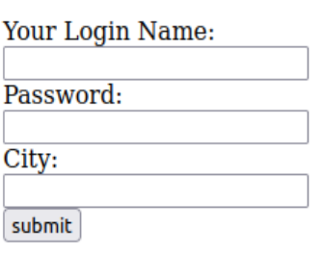
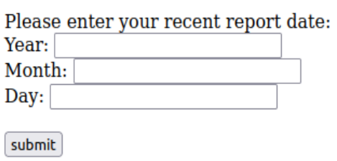
Task A.1
POTENTIAL POINTS OF REFLECTED XSS VULNERABILITY
Login page
Welcome Page
4
1
5
2
6
3
Why?
Any user input that is not validated/sanitised may be susceptible to a Reflected XSS Attack
FIT2093
ASSIGNMENT 3
TASK A
Notes:
I have identified a total of 6 potential points of reflected XSS vulnerability on the website, 3 on the login page, and another 3 on the welcome page.
All of these points marked on the slides are boxes that take in user input. If any of these user inputs are not properly validated or sanitised, a malicious user may exploit this vulnerability by supplying inappropriate inputs such as scripts in attempt to trick the server into running unintended programs.

Slide 4
Task A.2
TESTING FOR REFLECTED XSS VULNERABILITY - PROCEDURE
<script>alert("XSS Exploit")</script>
Most naive test
<SCRIPT>alert("XSS Exploit");</SCRIPT>
bypasses the check for <script> keywords
<img src=1 href=1 onerror="alert('XSS')"></img>
bypasses all checks for <script> keywords, even with case insensitive
FIT2093
ASSIGNMENT 3
TASK A
Notes:
I performed these tests for all 6 identified points of reflected XSS vulnerability.
The first test is the most naive reflected XSS attack, where I made an assumption that there is no input validation whatsoever in the website.
The second test assumes that there is a simple check for the lowercase <script> keyword, therefore it supplies an uppercase <SCRIPT> keyword instead.
The third and final test is the one that supplies a whole different tag, whereby the script is injected through different means, in this case it's through an image error argument. This completely bypasses all checks for the <script> tag.

Slide 5
Task A.2
TESTING FOR REFLECTED XSS VULNERABILITY - RESULTS
Login page
Welcome Page
4
1
5
2
6
3
Successful points:
Points 5 & 6
Unsuccessful points:
Points 1, 2, 3 & 4
FIT2093
ASSIGNMENT 3
TASK A
Notes:
After running the tests on the six points, I found out that only two of those points have reflected XSS vulnerabilities in them, which are the Month and Day input boxes in the welcome page.
I passed all three tests in these two vulnerable points, whereas for the other points, all the tests were unsuccessful.

Slide 6
Task A.2
TESTING FOR REFLECTED XSS VULNERABILITY - ANALYSIS OF RESULTS
Login Page
No Reflected Information
The web page accepts user input, but none of it is reflected back to the user's browser.
Welcome Page
Input Validation
The web page checks user input for special characters or malicious code.
Output Encoding
The web page performs some form of modification to the user input, such as encoding or sanitizing when displaying it back to other users.
FIT2093
ASSIGNMENT 3
TASK A
Notes:
Here are my interpretations of why and why not the reflected XSS vulnerability exists at the points.
In the login page, the user is prompted to enter their login information, but their input is not displayed back, therefore the reflected xss vulnerability does not exist in all three points.
Whereas for the welcome page, the input box for 'Year' does not have reflected XSS vulnerability. I think that there might be some form of input validation, which means that the web page filters out user inputs such as those with special characters that are used to represent code syntax, or HTML <script> tags that may be followed by JavaScript code.
The web page might also implement output encoding in that input box, that is the web page modifies the user input to remove potential malicious input. This is done before the web page displays the input it captured back to the user.
If it is not done, this results in a reflected XSS vulnerability because the malicious code or script entered by the user could be executed. Since the input boxes of 'Month' and 'Day' have such a vulnerability, it is most likely that these prevention measures are not implemented there.

Slide 7
Task A.2
TESTING FOR REFLECTED XSS VULNERABILITY - EXPLOITATION AND MITIGATION
Exploitation
Attacker enters malicious script as part of the input -> web page reflects malicious code back to browser -> misinterprets as code -> script is executed within the browser -> unauthorized access/data theft
Mitigation
Input validation
Output Encoding
Firewalls
Security Audits and Patches
FIT2093
ASSIGNMENT 3
TASK A
Notes:
An outsider attacker may not have information about the login credentials. Therefore it is very unlikely that they can exploit the vulnerability in the welcome page, since it requires them to log in using a valid account.
But in the case where an attacker is able to log in, Reflected XSS vulnerabilities can be exploited as such:
The attacker first embeds malicious code within specific characters or tags that resemble code syntax. When the unvalidated user input reflected by the web page to the browser, it is misinterpreted as code and the script is executed within the browser itself.
The scripts can be programmed to do a variety of things, such as giving unauthorized access to the attacker, or allow the attacker to obtain data that is originally denied access to.
Some ways to mitigate such a vulnerability include the two points discussed earlier, which are validating user input and encoding output. This filters out malicious user input and makes sure that the embedded scripts do not get reflected to the browser, or even executed by the browser.
A Web Application Firewall can also be set up to detect and block XSS attacks. The firewall can help inspect incoming inputs for malicious patterns and block potential XSS payloads.
Another way of mitigation would be to frequently perform security audits to find potential security flaws and apply appropriate security patches to resolve the issues.

Slide 8
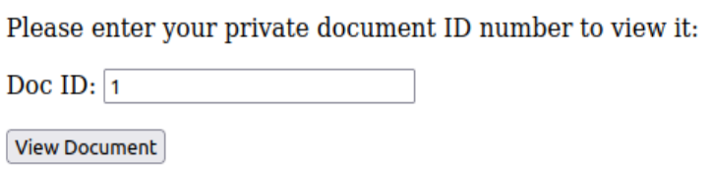
Task B.1
GAINING UNAUTHORISED ACCESS TO PRIVATE DATA - VULNERABILITY FOUND
Submitting a View Document Request
Screenshot of Request Intercepted by Burp Suite
The document ID and user ID are in plain sight! (DocID and uIDrx)
FIT2093
ASSIGNMENT 3
TASK B
Notes:
Using the Burp Suite tool, I intercepted the request to view a document while logged in as Bob.
From the intercepted request, we can see that the value of DocID is 1, and the value of uID is 1. This corresponds to the document ID I wanted to find, and the user ID of Bob.
This indicates that it may be possible for Bob to alter the values to these arguments to gain unauthorised access to private information.

Slide 9
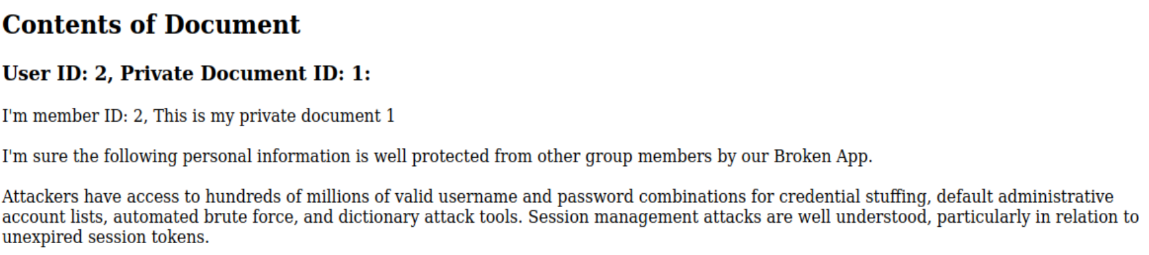
Task B.1
GAINING UNAUTHORISED ACCESS TO PRIVATE DATA - EXPLOITATION
Changing the argument of uIDrx to 2
User ID: 2 is Charlie!
FIT2093
ASSIGNMENT 3
TASK B
Notes:
Trying out my hypothesis, I intercepted the view document request submitted as the user Bob, which has user ID of 1.
Now I alter the uIDrx argument's value to 2, which is the User ID of Charlie.
Forwarding the request, the website successfully loads Charlie's private document.

Slide 10
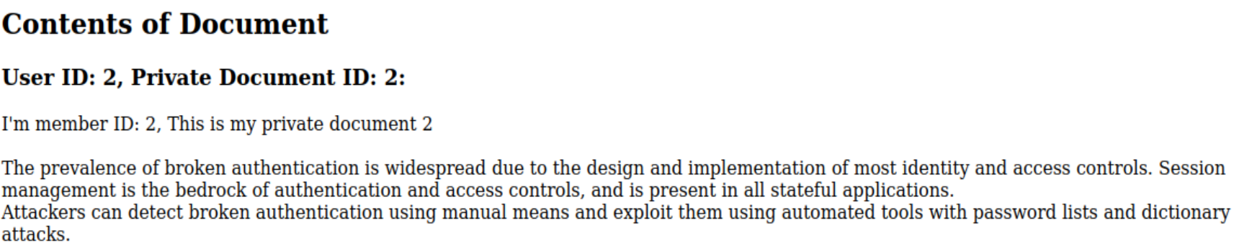
Task B.1
GAINING UNAUTHORISED ACCESS TO PRIVATE DATA - EXPLOITATION
Changing the argument of DocID to 2 and uIDrx to 2
User ID: 2 is Charlie!
FIT2093
ASSIGNMENT 3
TASK B
Notes:
Further tests are conducted where I change not only the User ID, but also the document ID. Here I made two changes, where both the user ID and the document ID are changed to 2 in the intercepted request.
After forwarding the request, I can also access Charlie's second private document as Bob.

Slide 11
Task B.1
GAINING UNAUTHORISED ACCESS TO PRIVATE DATA - ANALYSIS OF RESULTS
Why did the attack succeed?
Lack of CSRF Protection
No CSRF Token
Attacker can intercept, modify and forward request
Server still accepts modified request
Storing Information in Plain Sight
DocID and uIDrx are directly exposed in the HTTP request
Attacker can craft request with known values
FIT2093
ASSIGNMENT 3
TASK B
Notes:
Here are some reasons of why Bob can perform a CSRF attack to gain unauthorised access to Charlie's private documents.
First of all, the request does not have a CSRF Token implemented. This makes CSRF attacks easier to be carried out since there is no form of validating the request's authenticity.
Also, since the arguments are stored directly in the request, and the other user's ID is already known to Bob the attacker, he can easily modify the request to target the specific user and their documents to obtain private information.

Slide 12
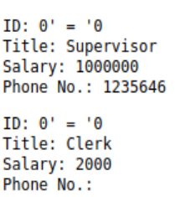
Task C.1
SQL INJECTION VULNERABILITIES - LOOKING UP PRIVATE INFORMATION
a) Listing users in the database containing user information
Using 0'='0 as input
FIT2093
ASSIGNMENT 3
TASK C
Notes:
First I provide this command as an input.
Since the database does not sanitise user input and supplies the input to the query as-is, I can exploit this vulnerability to inject such a command.
Becuase there are already single quotes supplied within the SQL query, this command works to always return True, which will return all instances in the database, therefore providing a list of all the users and their respective information.

Slide 13
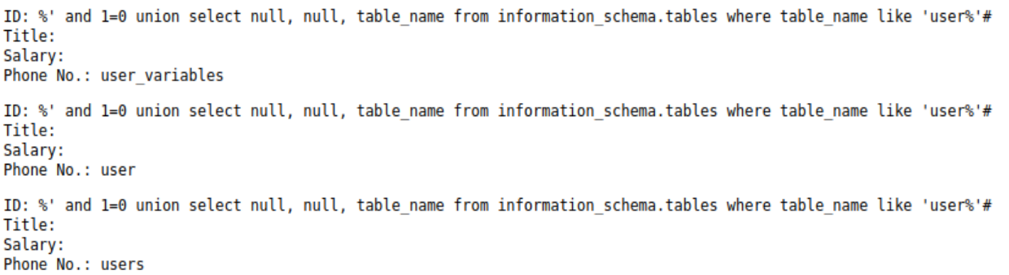
Task C.1
SQL INJECTION VULNERABILITIES - LOOKING UP PRIVATE INFORMATION
b) Determining the name of the database containing the user information
%' and 1=0 union select null, null, table_name from information_schema.tables where table_name like 'user%'#
FIT2093
ASSIGNMENT 3
TASK C
Notes:
Next, I tried to find the name of the database containing user information.
This command I supplied as an input can be broken down into 3 parts.
The first part is where the we want the query to be false, so that it does not return unnecessary information from the database.
The second part is where we select the fields to query from using SQL injection. Here I decided to display the database name in the Phone Number field, which is why I wrote two nulls for the two other fields to be empty.
The last part of the query is the like 'user%' filter in the WHERE clause. Since my point of interest is in the database containing user information, I use the keyword user followed by the variable length wildcard character to obtain possible names of the database.
Here we can see that user and users are most likely to be the database that I'm looking for.

Slide 14
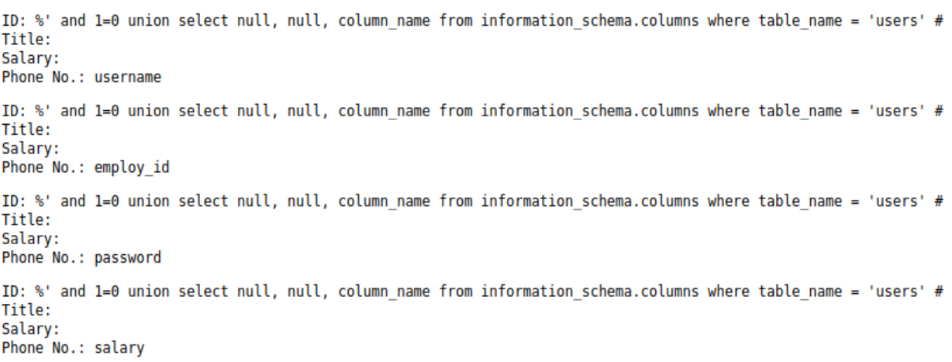
Task C.1
SQL INJECTION VULNERABILITIES - LOOKING UP PRIVATE INFORMATION
b) Determining the corresponding fields (columns) in the 'users' table
%' and 1=0 union select null, null, column_name from information_schema.columns where table_name = 'users' #
FIT2093
ASSIGNMENT 3
TASK C
Notes:
In a similar logic of what I did previously, here I tried to obtain all the column names of the table name called 'users'
As we can see, this is the table that I wanted to find. It has user information such as the username, the employee id, the password and many others.
I have included the screenshots of the results in the slides. There are quite a number of columns present in the table, so I will quickly show the rest of the results over the next few slides.

Slide 15
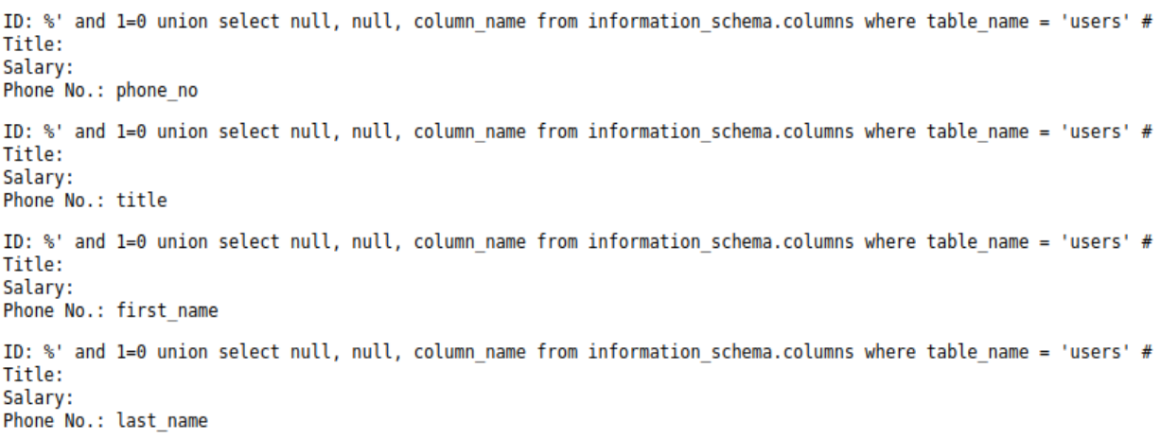
Task C.1
SQL INJECTION VULNERABILITIES - LOOKING UP PRIVATE INFORMATION
b) Results extended
FIT2093
ASSIGNMENT 3
TASK C

Slide 16
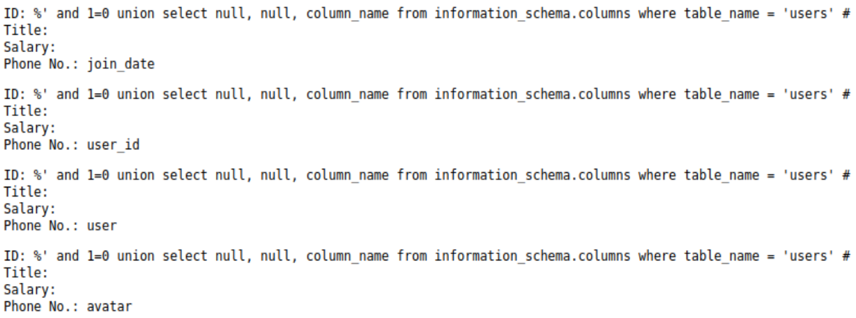
Task C.1
SQL INJECTION VULNERABILITIES - LOOKING UP PRIVATE INFORMATION
b) Results extended
FIT2093
ASSIGNMENT 3
TASK C

Slide 17
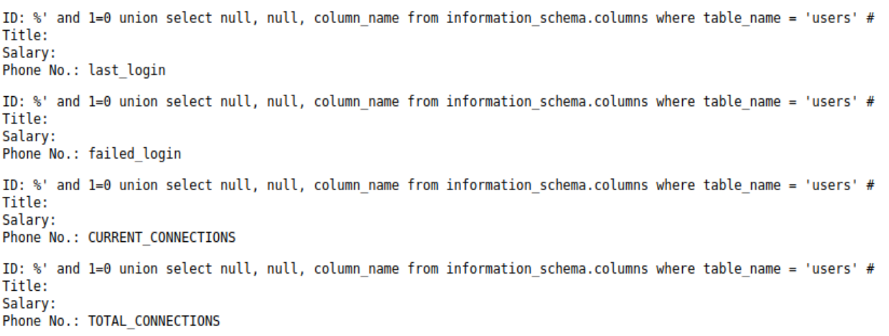
Task C.1
SQL INJECTION VULNERABILITIES - LOOKING UP PRIVATE INFORMATION
b) Results extended
FIT2093
ASSIGNMENT 3
TASK C

Slide 18
Task C.2
SQL INJECTION VULNERABILITIES - LOOKING UP PRIVATE INFORMATION
b) Results extended
FIT2093
ASSIGNMENT 3
TASK C

Slide 19
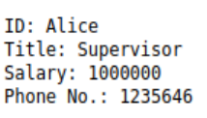
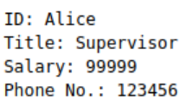
Task C.2
SQL INJECTION VULNERABILITIES - MODIFYING THE TABLE
a) Updating information using the fields
123456', salary = 99999 where username = 'Alice'; #
b) Results: Before and After Change
Before Change
After Change
FIT2093
ASSIGNMENT 3
TASK C
Notes:
Here I exploited the UPDATE code format to perform an update to a field other than the phone number in the database.
By supplementing a single quote, followed by a comma and a new column_name = value statement, I can perform updates to other columns. I also supplied the argument as to which row in the database I wanted to change.
Here I successfully changed Alice's salary from 1 million to 99999.

Slide 20
Task D
PRIVACY AND ETHICS - DISCUSSION
Part A - Reflected XSS
Privacy
Injected code can potentially access sensitive information when executed in the victim's browser
Ethical Issues
Privacy Violation
Unauthorised Access and Account Hijacking
Malicious Content Dissemination
FIT2093
ASSIGNMENT 3
TASK D
Notes:
Moving on to the final part, I will discuss the privacy and ethical issues of the three parts A, B, and C separately.
First of all, part A which is reflected cross-site scripting. This attack can compromise the privacy of an individual when successfully carried out. Since the victim's browser is able to execute whatever script the attacker embeds into the website, the attacker can craft a script to compromise information such as login credentials, personal data, or financial details entered by the user.
The ethical issues that could arise from such an attack include users' privacy violation, unauthorised access to users' accounts, as well as the dissemination of malicious content.
The malicious scripts that are injected into web pages allows attackers to steal information such as login credentials, personal information, etc., which violates users' privacy.
The attacker can also inject scripts that execute actions on behalf of the user, such as manipulate account settings, perform transactions, or even impersonate the user.
The script injected may also redirect users to malicious websites, distribute malware, or engage in phishing campaigns. This exposes susceptible users to harmful content.

Slide 21
Task D
PRIVACY AND ETHICS - DISCUSSION
Part B - CSRF
Privacy
User privacy can be breached when attacker modifies HTTP request to obtain originally private information
Ethical Issues
Privacy violation
Unauthorised actions
Accountability and liability
FIT2093
ASSIGNMENT 3
TASK D
Notes:
Part B is where a CSRF vulnerability exists within the website.
In a real world scenario, this would be a breach of user privacy, as the attacker is able to get ahold of sensitive information without the need to log in as the authentic owner of the files. This is a clear violation of privacy.
This attack is related to several ethical issues, such as privacy violation, unauthorised actions, as well as accountability and liability.
CSRF attacks that intercept and modify HTTP requests can result in privacy violations. Attackers may manipulate requests to expose or modify private information, such as personal details, preferences, or sensitive data.
CSRF attacks can also exploit the trust and authentication of a user to perform unauthorized actions on their behalf. This can include modifying account settings, making financial transactions, or changing sensitive information without the user's knowledge or consent.
Ethical considerations also extend to the accountability and liability of the parties involved. When an attacker intercepts and modifies HTTP requests through CSRF, it may be challenging to trace and attribute responsibility accurately. Determining liability and addressing the consequences of such attacks can pose ethical dilemmas.

Slide 22
Task D
PRIVACY AND ETHICS - DISCUSSION
Part C - SQL Injection
Privacy
Upon success, the attacker can access, modify, or delete potentially sensitive data in the database.
Ethical Issues
Privacy Violation
Data Breaches
Reputational Damage
FIT2093
ASSIGNMENT 3
TASK D
Notes:
SQL injection attacks can have severe privacy implications for individuals.
If the attacker succeeds in the attack, this could lead to a privacy breach where the attacker has access to a variety of sensitive data such as personal information, financial records and more. What's more, the attacker can perform actions such as modifying or deleting such data, compromising private information stored in the database.
The ethical issues pertaining to such an attack include violation of user privacy, potential data breaches, and the damage of the application's reputation.
As mentioned earlier, the attacker can have unauthorised access to sensitive data, which violates the users' privacy.
Attackers may also steal, modify or delete data in the database. Users might lose trust in the applications that store their information and choose to not use or even sue the company-in-charge for their loss.

Slide 23
Thank you!
CHEN XI DIONG
29 MAY, 2023
FIT2093
ASSIGNMENT 3

